Slide 2






Where
To Go
Explore
At Your Destination
How To Get There A-B
Discover
Along The Way
2
Notes:
MQ History
I think you’ve all heard of MapQuest. We’ve been giving folks directions online for over 15 years.
<me intro>
Recently, people have wanted more and more of local discovery. Getting directions from A to B is easy, but figuring out B is the hard part.
That’s what people want to know. A bunch of us here are from out of town -- how’d you find the best place to eat? Or if this hotel is booked up, where’d you decide to stay?
Lots of data that we could look at, too much data, just causes decision paralysis from the noise
lots of contradictions
bad things sound scary. scary enough to outweigh all the good things (one report of bed bugs outweighs 20 reports of clean?), we start to build personal filters/methods to understand the data
everything is 3.8 stars
Almost always end up with a “trusted source” -> what a friend said, what the company’s “preferred” hotel is, etc
This need for clean actionable data, in a vast sea of information is what we’re all trying to do. THis is what “location” is all about.
How we approach the problem is what gets interesting

Slide 3

Data = Confusion or Solution
Notes:
Lots of Data- can either lead to confusion or solutions:
This need for help wading through a sea of information isn’t unique to “location apps”
- Real estate agent -> can just use Zillow, but you get a “trusted local person” involved to augment it, especially when you’re moving and you want a “local expert”
- FB tweaking the news feed to be more about “people you care about”, less of a noise from someone you think you went to high school with, so you friended them, but you’re scared to defriend because they might get upset.
- The tools we’re writing (we like to think) are based in the same science that help any one combing through data medical researchers comb through mountains of data looking for nuggets and links... whether its for medical research or even for

Slide 4
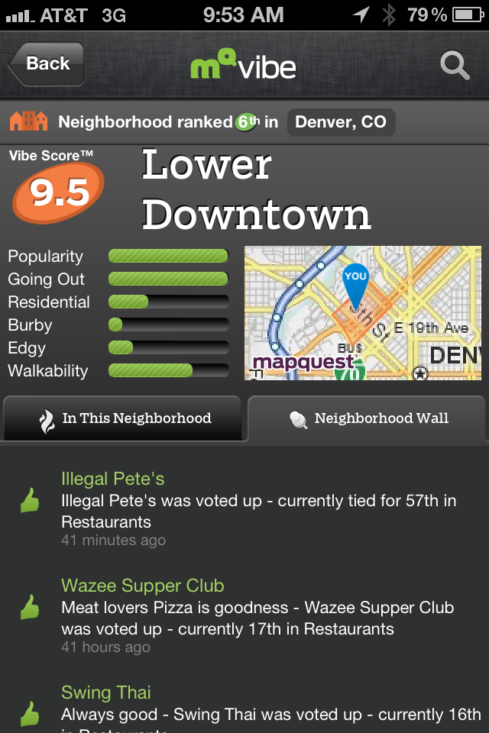
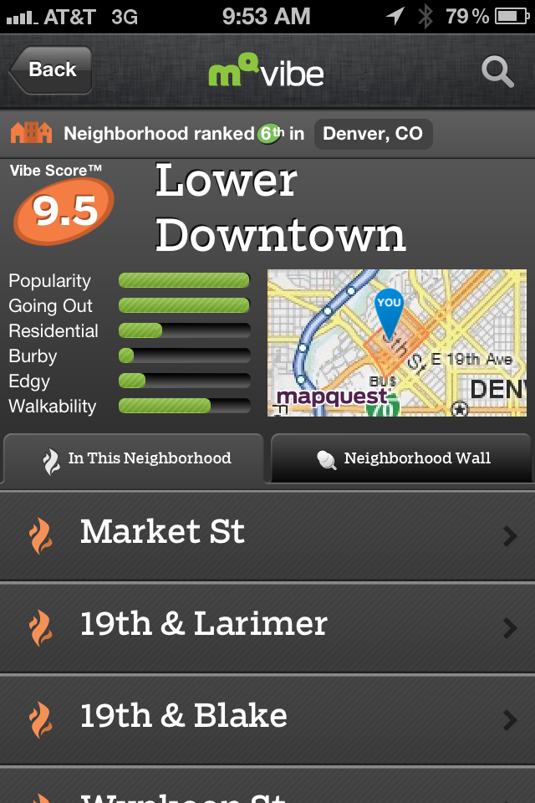
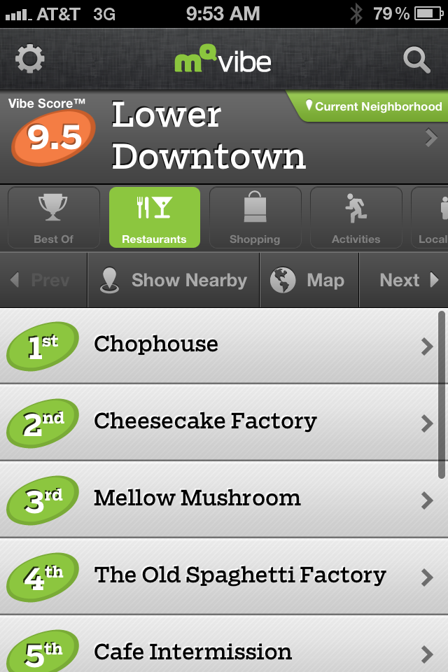
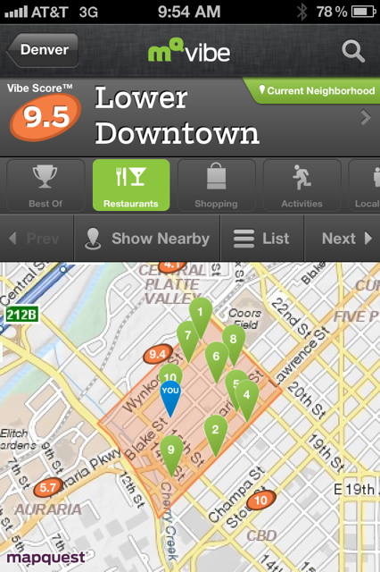
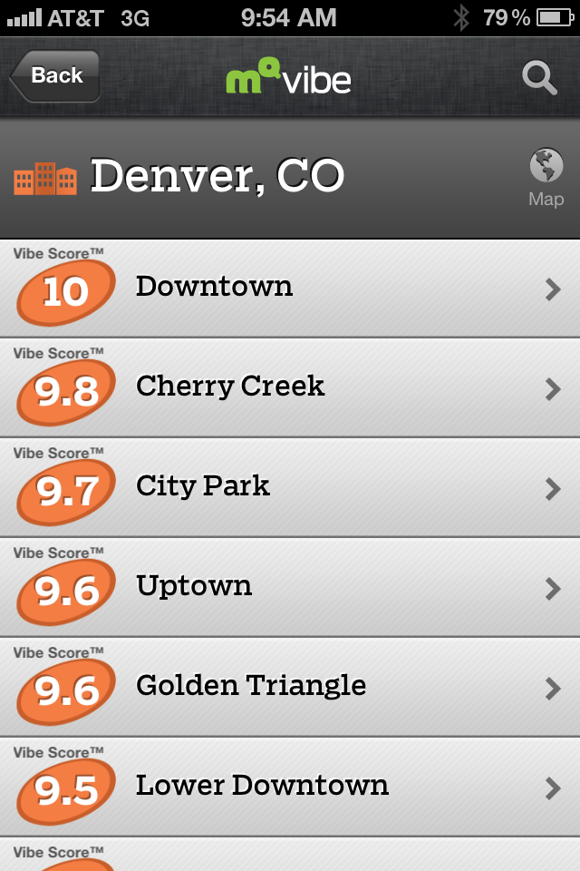
Relevant Data = MapQuest Vibe
Massive Scale- 50k neighborhoods/50k hotspots/30k cities
Blended social-algorithmic rankings
Discovery of places & businesses
Community engagement & influence
4
Notes:
Consumer solution: MapQuest Vibe

Slide 5
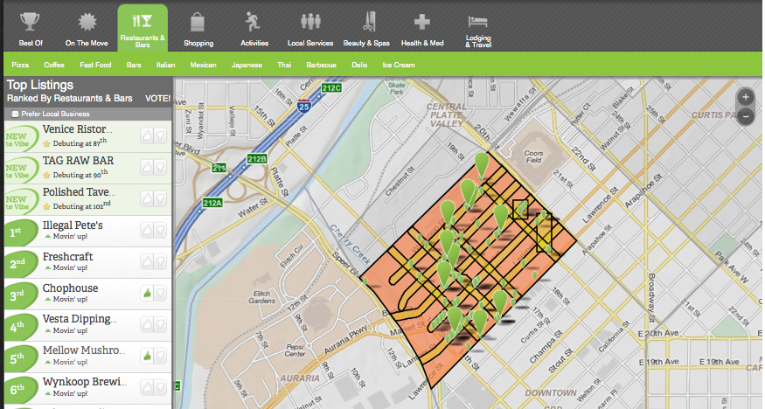
Algorithms For Big Data
Vibe Rank
Notes:
Let’s dig into mqVibe for more clarity:
Two traditional ways for giving local guides and recommendations
1. Single data point -> POI level - too granular, doesn’t provide context,
Tropea Example
2. Gigantic data set -> City level - too coarse, I don’t really want to drive across town
3. The recent pivot is more location aware, with radius searches, etc -> this is a targeted subset
“What’s cool around me?”
Generally apps today are still missing a crucial piece
Where should I go so that there’s a lot of cool stuff around me? How do you package that?
That’s the core problem statement
If I’m already there, tell me what’s cool.
Or tell me where to go hang out and then help me decide what to do.
Mimics real life -> drop baby off at parents and couldn’t decide where to eat, but decided “let’s hit up Pearl Street mall” and wander around until something sounds good.
The additional wrinkle is personalization
Tell me if anyone I know is around so we can pop in and say hi
Tell me if someone I know recommended a place nearby or remind me if it someplace I keep meaning to go eat at
But keep it to my “trusted circle” or people that are similar to me. Not all my 635 “friends” on FB are necessarily ones that I want to listen to...
Where should i go? (or even live)
What should I do there?
Opportunity to shape the rankings/ratings/reviews.
Key point: eliminated the noise from too many inputs for our users by
using rankings over “clustered around the mean” ratings
allowing for contextual targeting from “food in denver” to “japanese food at the 16st and Market hotspot”, whole city level to single city block + cuisine level
layering in explicit signals
friends’ recommendations -> Chris liked this place, let’s try it!
Bottom line: make decisions quickly and in real-time, instead of spending 30 minutes on your computer wading through all the noise
<expand to larger discussion on VibeRank (variables, inputs), consider dropping other pieces>
Have the data, have the great engineers, have the PMs that live outside the box
But, reducing big data to quick decisions isn’t easier, “getting the signal out of the noise”.
Time of vote - voting on restaurants at night
Location of vote - voting on the couch
How do you balance an implicit vote with an explicit vote?
Generally count more, since it’s a deliberate event, but you have a sampling error. Perhaps the person that votes is a different beast from the general population.
How do you balance a recent vote vs an old vote?
Generally count more, more relevant, especially as you have major updates to restaurants and hotels
How do you balance a solitary vote vs. one that came from someone that voted on 5 other things (contextual)?
Might “adjust” other votes, by assuming some relativity -> opposite votes on two mexican restaurants, likely implies a relative anchoring
How do you balance census info or real estate value changes with other changes?
Usually see these are predictive indicators -> “rising popularity”
Engagement Platform
What we have is a large-scale and location-at-the-foundation engagement platform
Sure, we do the usual badging, etc
But what we build is a system where we have a very strong intent drive user action
As you all know if targeted correctly it can delight the user and the advertiser -> example, FourSquare deals w/ restaurants... if the second best sandwich shop has $5 off or I’m one visit away from a free cookie, then...
Key Point: eliminate the noise the advertisers... if you only care about people looking for sushi nearby, then we won’t try to engage people 20 miles away that are looking for burgers
The inherent targeting is going to let us eliminate the noise if
If i’m looking for pizza, I don’t care that there’s a Groupon for mud baths nearby
If I’m looking for pizza in a hotspot that’s the intersection of two streets, a pizza place will pay much more for a chance to put a deal to me. And as a user, I’m not that annoyed by it. Especially if it’s saves me money on something i was going to buy anyway.
Revenue Potential
Take 50K neighborhoods and add in 30K towns (too small to have neighborhoods) and suppose I could make $1/day in each one -> 80K*1*365 = nearly $30M
Two pieces to the puzzle:
1) get users there, which we’ll skip, given the time constraints and focus of the track\
2) provide value to the advertisers -> eliminate the noise (users that aren’t going to be coverted) and go after those that are important.

Slide 6

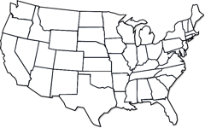

Relevant Data = Consumer Insight + Targeting
  We know where people are and where they are going.
  Search
  Analysis
  Demographics
  Consumer behavior & demos on 1 in 6 people on Internet.
  What they’re searching for, and when they’re searching. Reveal Client and competitor insights.
  Geo
  Analysis
  Targeted Ad Ops
  Detailed regional analysis including day-parting and geographical insights.
  MapQuest Vibe, MapQuest Trip Planning (web/mobile)
6
Notes:
6
6
Big Data advertiser solutions:
What we bring and can bring to location-based advertisers
1) talked about the strong location and intent targeting
2) demographics -> based on usage history and other profile info. For example, you can tell a lot of someone based on what places they have liked or voted up, or even what car(s) they drive
3) conquesting -> ability to target users going to your competitors
4) trends -> big data, big patterns
5) geo-analysis/variability -> again from big data
6) time targeting -> people are more likely to be looking for a place to buy clothes at <time if on mobile> or <time if on desktop>
&) Weather or even influenza targeting -> soup restaurants
Combine it with a campaign on MapQuest (35% market share, etc)
-> can drive customers from “pages to parking lots” with a well designed campaign
-> provide a place to Engage, Influence, and Intercept -> no more cluster bombing with “brand impression ads”, by eliminating the noise on both ends, we get solve the problem favorably for both groups
Because we are used in both a travel and local context – we can tell identify a lot of interesting things about user intent.
We can combine data about our audience with their actual behaviors and intentions to provide better targeting,
We log between 15 -20m search requests per day that capture trip origins and destinations. 80% address and 20% POIs
We know a lot about what people search for, how far they drive, and when they search – by combining these together we can create value insights for better targeting on MQ.
Eg: want to target all folks searching on MQ for Home Depot’s, Lowes and Ace Hardware- home improvement category on Fridays.

Slide 7
Advertising Opportunities
Pages to Places:
Engage, Influence, Intercept
7

Slide 8
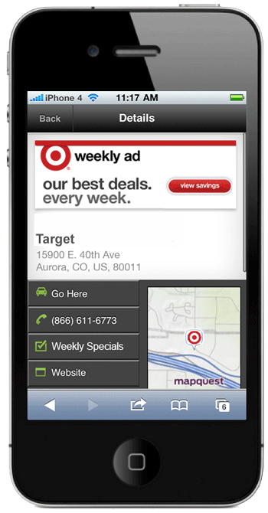
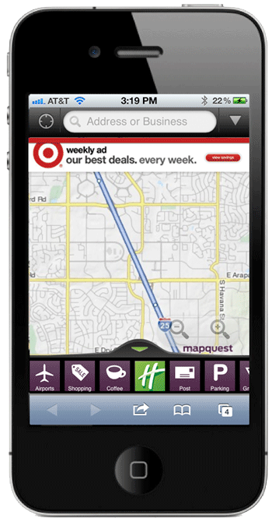
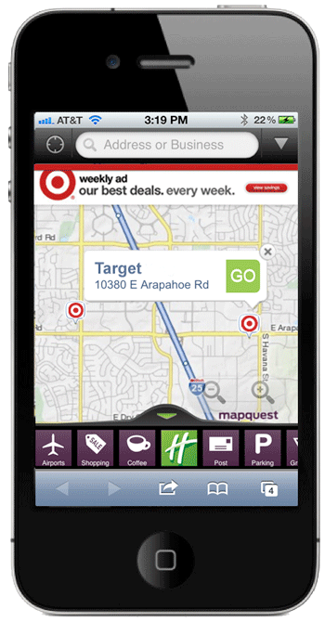
Mobile Banner Locator
Branded banners to actively engage mobile consumers who are logging millions of searches per week on MapQuest, and drive them into your stores.
When users click on a branded banner, map populates with stores relevant to users’ locations.
Tier 2 POI Actions:
• Add to Route
• View Details Page
• View Local Ad/Coupon
8

Slide 9
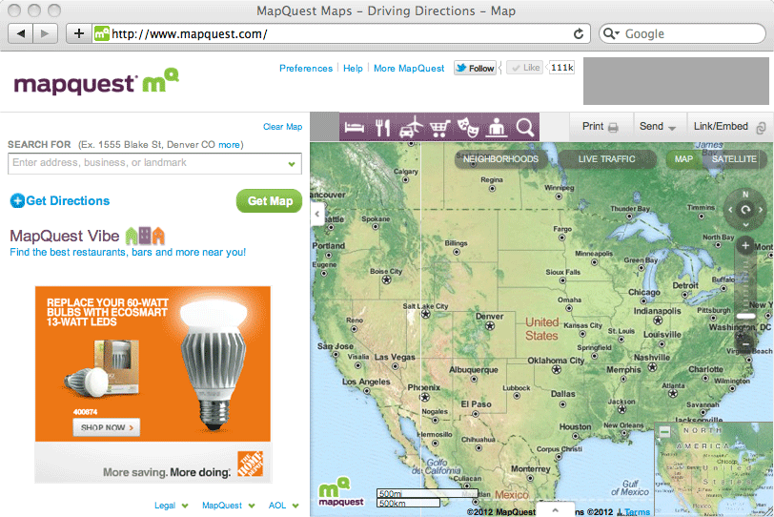
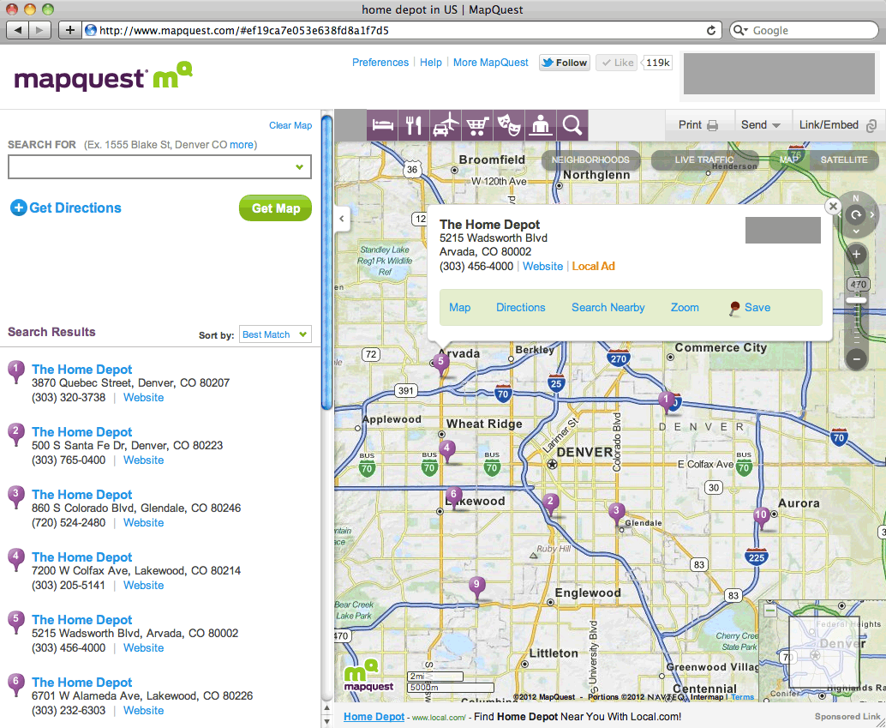
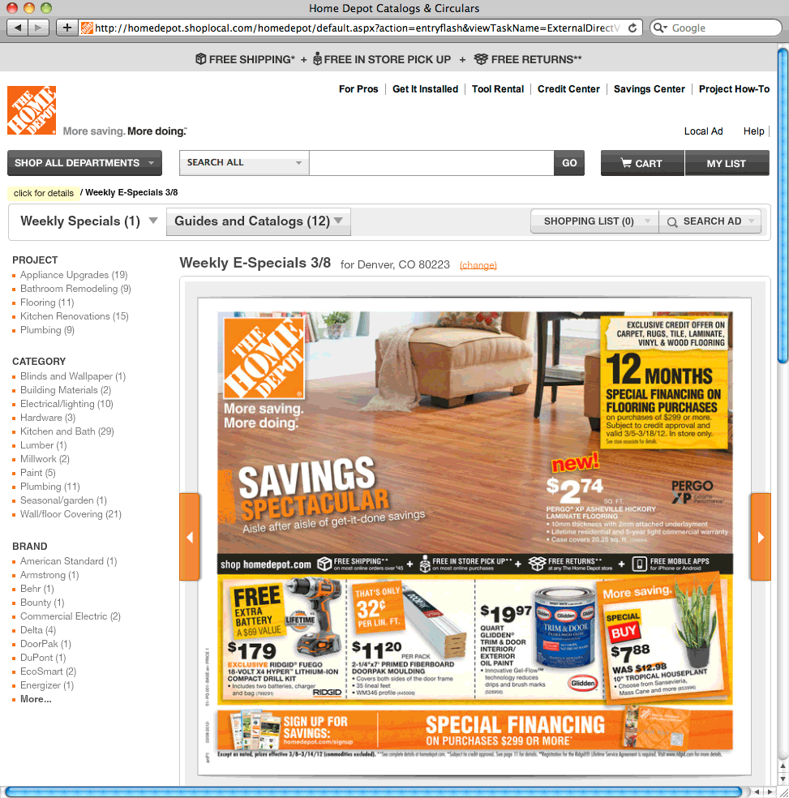
Desktop Banner Locator
Targeting Capabilities:
Your targeted opportunity to influence decisions while planning, along the way, as well as at and around destinations.
Click to be taken to coupon / local circular
Click to populate locations near you
9
Notes:
Consumer insight + targeting ad opportunity example:
Banner Locator – This gives the advertiser all the benefits of a customized marketing message and targeting capabilities and with the benefit of driving user to store fronts –
Works well for CPGs looking to drive traffic to the stores that sell their goods. Where to buy…
Can also include local offers

Slide 10




Relevant Data = New Trip Planning Solutions
• Travel Inspiration
• Itineraries
• Best of: Restaurants, Shopping, Travel
• Trip sharing
Desktop
• Advanced Trip Planning and for Local Discovery at Destination
• On The Go
Discovery
• Search on Map,
Get Directions
• Relevant local deals
• Enhanced Along-the-Way Experience
Mobile
• Local discovery on the go, in market, and just in time: Great Restaurants, Best Shopping, Cool Things To Do
10
Notes:
Where are we going with our Big Data? What’s next?
Research has shown that MQ is considered a top travel site for helping people plan their road trips. 85% of leisure travelers drive to their destination by car, motorcycle or RV. 129M people each year.
82% of business travelers drive.
More solutions to making trip planning fun and easy using big data, tools and social signals.

Slide 11
Thank you.
Vijay Bangaru
vijay.bangaru@mapquest.com
11
11

